Slide 1

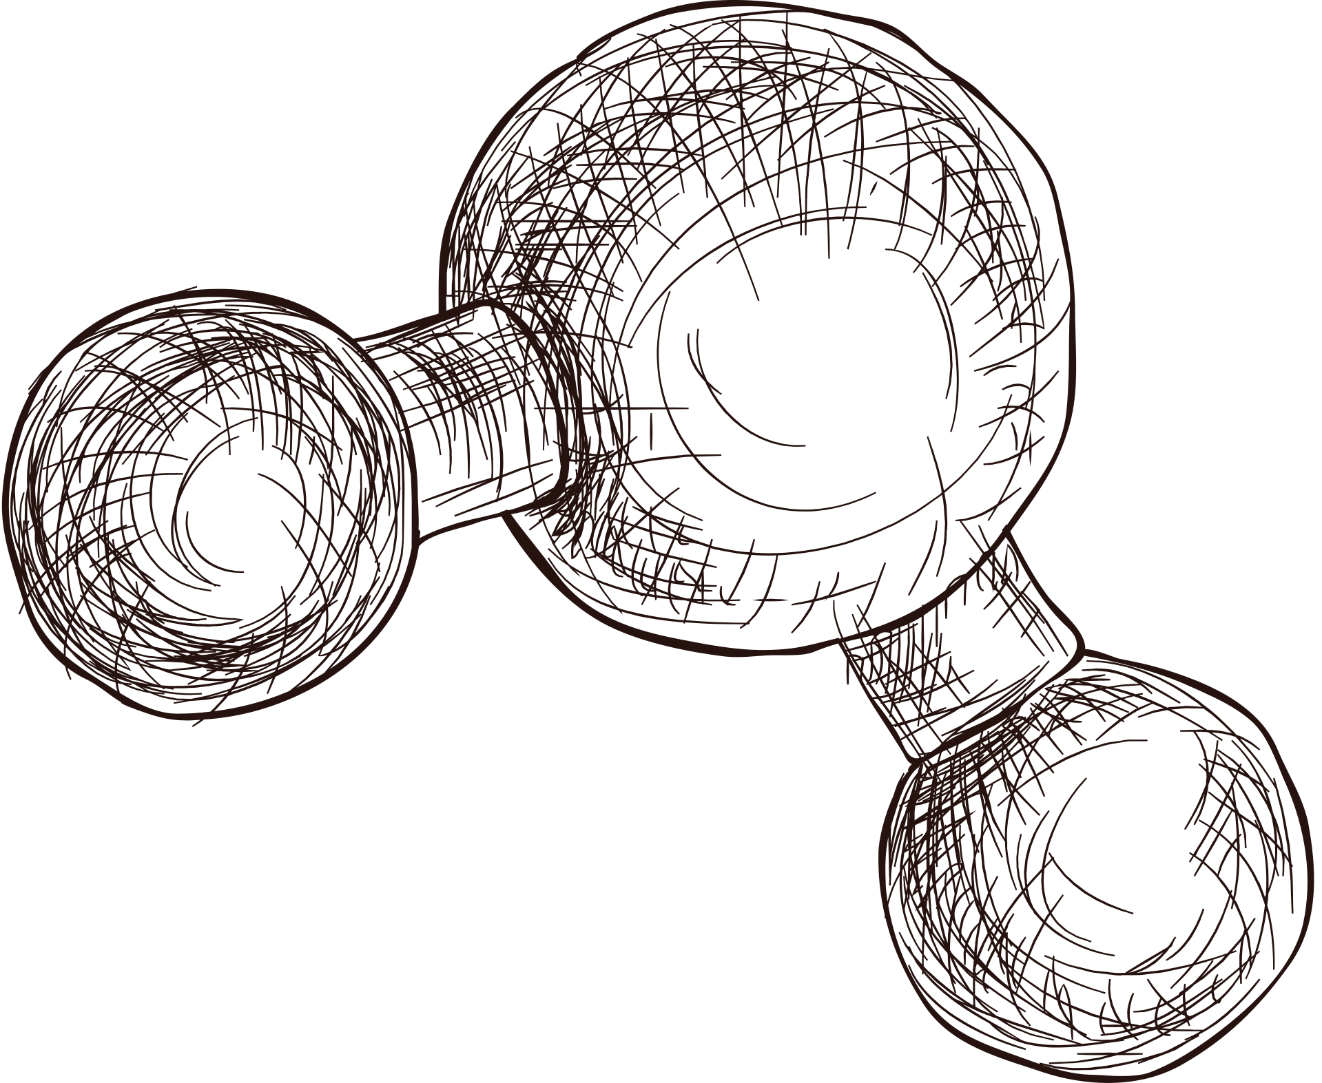
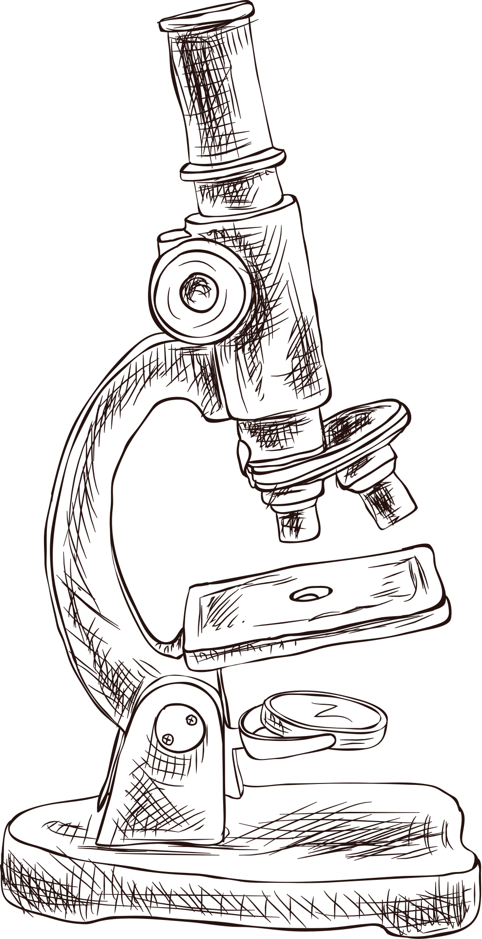

MBIOT PORTFOLIO PRESENTATION
Presented by Palak Nagar

Slide 2



CONTENTS
Core Competencies Reflection
BIOT 685: Directed Studies
BIOT 684: DirectedProfessional Internship

Slide 3

Core Competencies Reflection

Slide 4
Mastered molecular biotech, immunology, bioprocessing concepts
Hands-on experience with PCR, cloning, expression
Studied immune signaling and vaccine development
Explored enzyme kinetics, microbes, bioprocess systems
Attended seminars on emerging biotech trends
Learned strategic thinking and biotech leadership
Solved real-world challenges in capstone project
Gained insights from industry guest speakers
Practiced innovation, venture creation simulations
Built team management and influence skills
2. Leadership, Business, and Management Skills
1. Application of Advanced Biological Sciences Knowledge

Slide 5
Interpreted PCR, sequencing, protein quantification data
Analyzed gene expression using bioinformatics tools
Learned validation and reproducibility best practices
Wrote scientific papers based on research
4. Technical and Laboratory Expertise
Trained in ELISA, flow cytometry, blotting
Practiced GLP and lab quality standards
Taught mitosis labs as teaching assistant
Familiar with biosafety and lab audits
3. Data Analysis, Interpretation, and Implementation

Slide 6


BIOT 685:
DIRECTED STUDIES
Dr. Pushkar Lele Lab

Slide 7


Project Objectives
Importance of
β-lactamase enzymes in antibiotic resistance

Slide 8
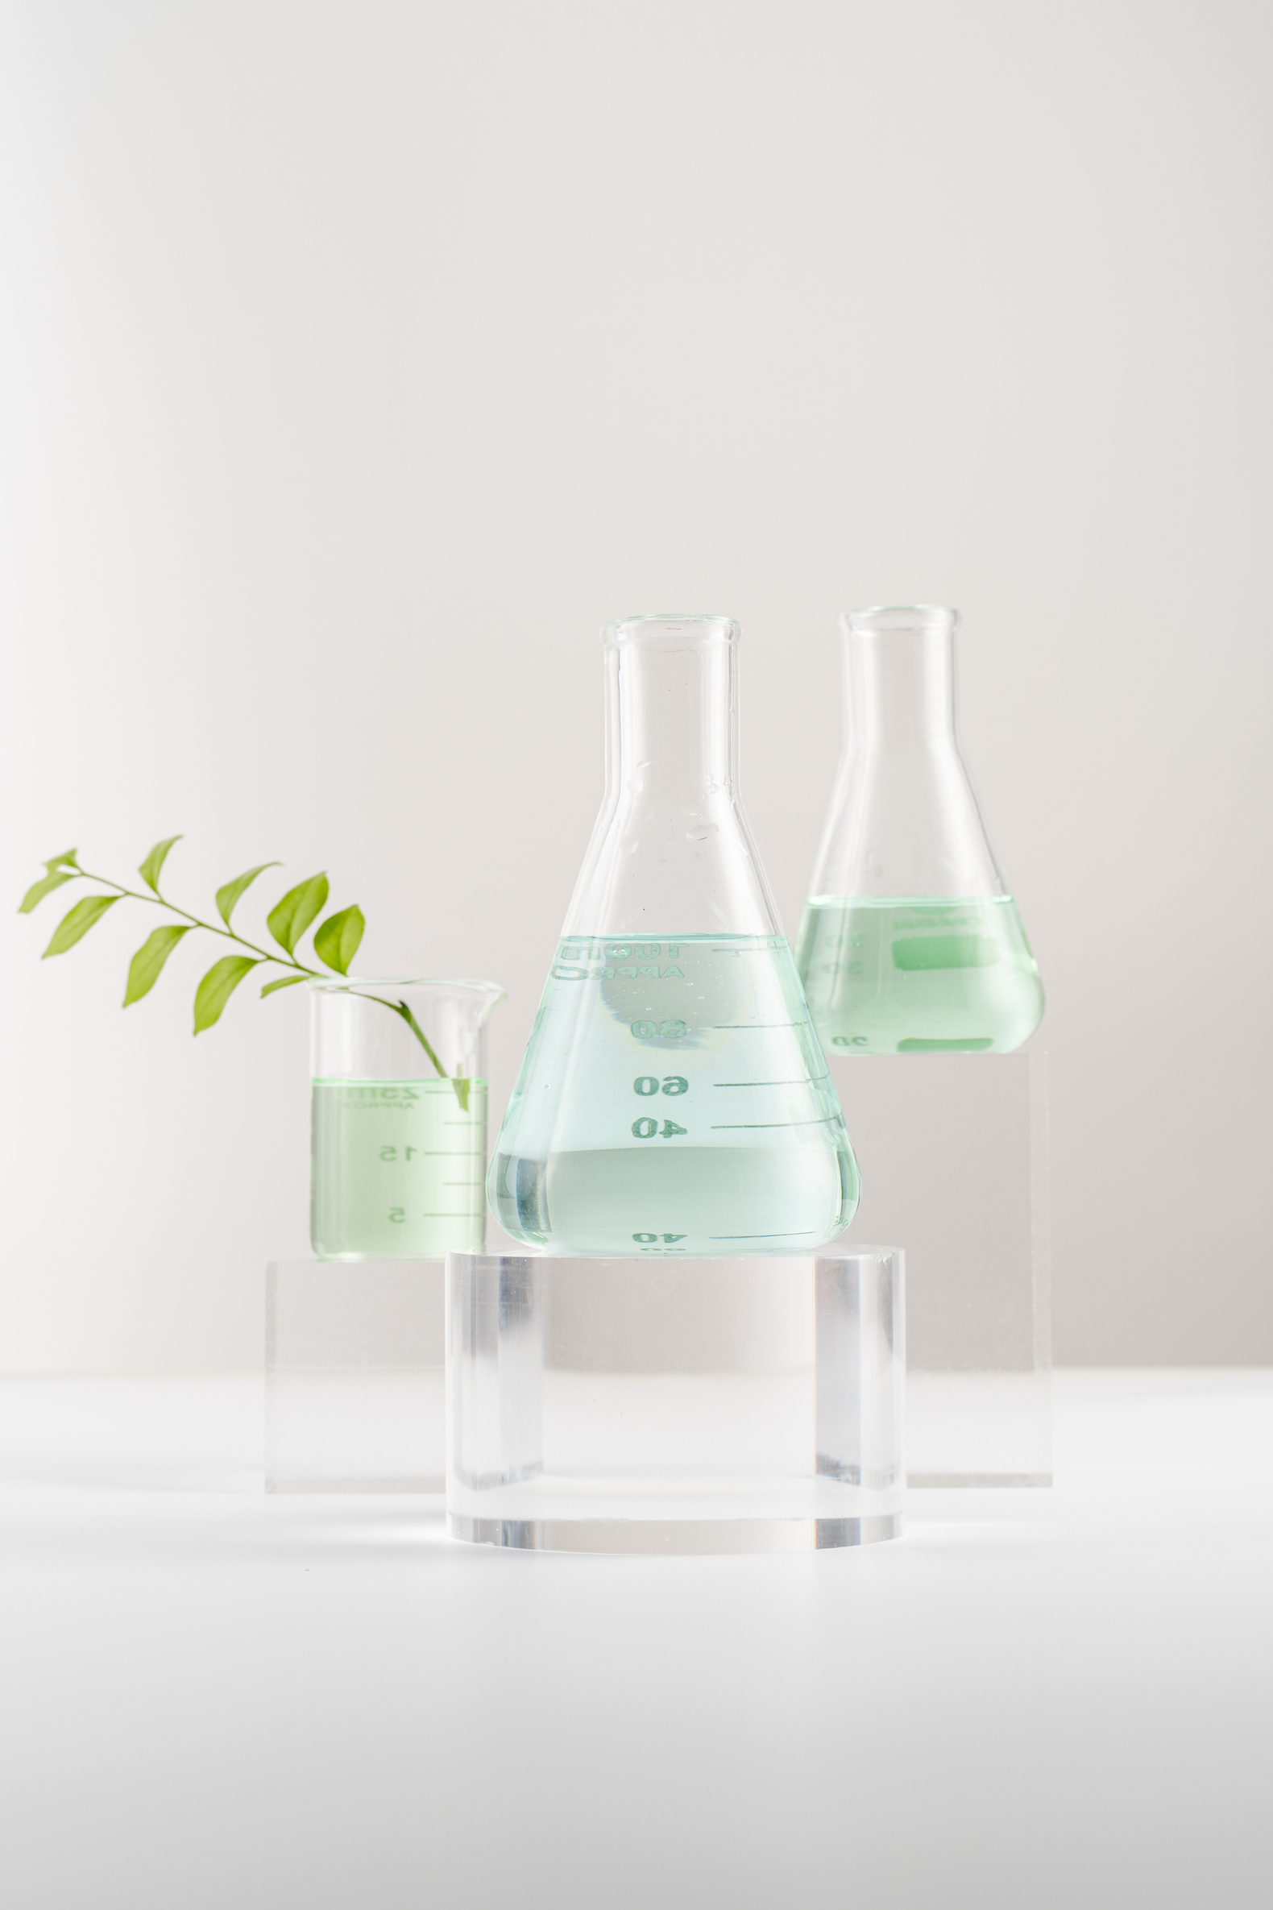
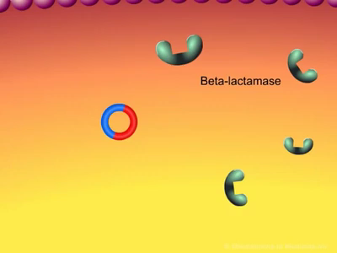
Introduction
01
Beta-lactamases are enzymes that bacteria produce, conferring resistance to β-lactam antibiotics like penicillins and cephalosporins.
02
Critical Role: β-Lactamase enzymes are pivotal in antibiotic resistance, undermining the efficacy of β-lactam antibiotics.
03
They achieve resistance by hydrolyzing the β-lactam ring of these antibiotics. Hydrolysing the ring deactivates the antibiotics, rendering them ineffective.
04
Monitoring beta-lactamase activity within bacterial cells is crucial. It aids in understanding antibiotic resistance mechanisms.

Slide 9
β-LEAF Assay:
Detects β-lactamase via fluorescence in live cells.
No lysis needed; probe lights up.
Nitrocefin disk turns color on contact.
Real-time activity assays of β-lactamases in E.coli
E. coli induced, washed, and analyzed live.
UV-Vis tracks antibiotic breakdown.
Shows real-time enzyme activity
METHODS
Phenotypic & Gene Detection:
Uses color change, MS, and fluorescence.
PCR/LAMP detect resistance genes.
Combines enzyme and gene detection.
NFAT Blue/Green Assay:
High-sensitivity, real-time in mammalian cells.
Tracks intracellular protein activity.
Ideal for screening and diagnostics.

Slide 10

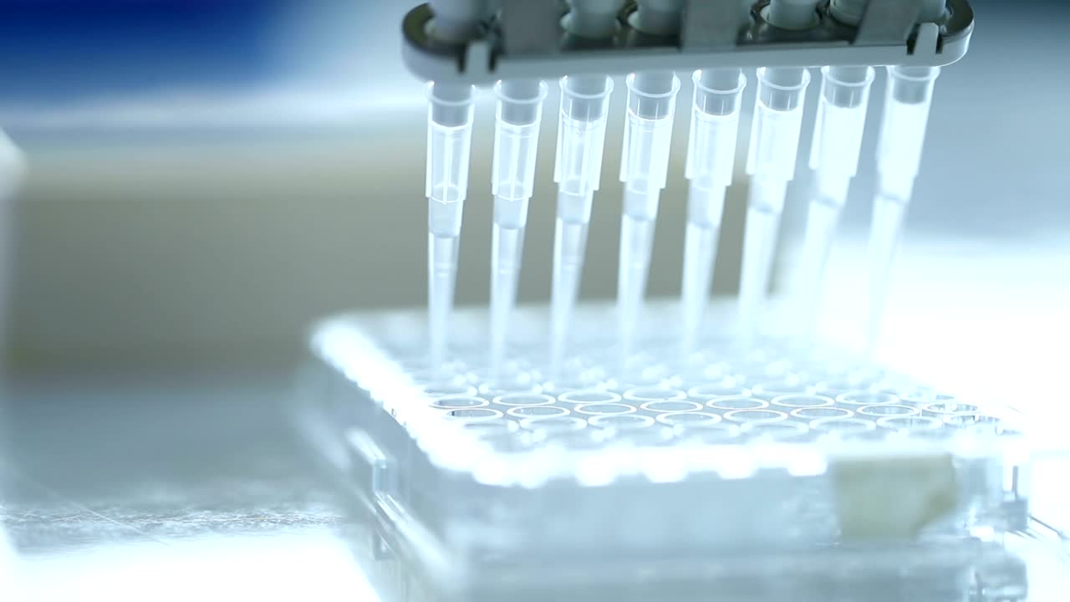
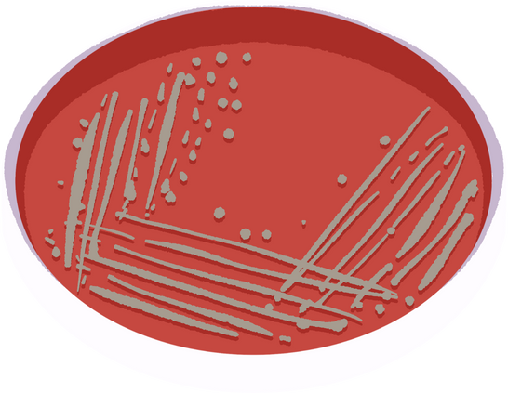


B-Leaf Assay
Preparation of Bacterial Cultures
Preparation of Probe Solutions:
A stock solution of the β-LEAF probe was prepared in DMSO, and a working solution was prepared by diluting the probe in PBS.
Culturing Bacteria:
Setting Up Assays:
Bacterial colonies were transferred to phosphate-buffered saline (PBS) to create a homogeneous suspension with a known concentration
of colony-forming units
Assays were performed in 96-well plates. Bacterial suspension, antibiotic solution (if testing antibiotic activity), and the β-LEAF probe solution were added to the wells.

Slide 11
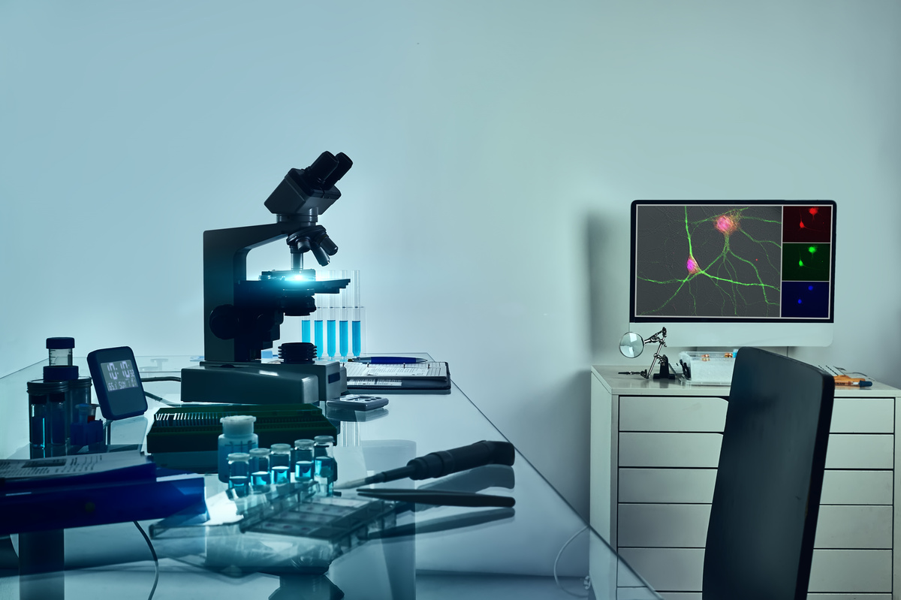

Monitoring Fluorescence:
Fluorescence was monitored over time using a plate reader. The excitation and emission wavelengths were set to detect the fluorescence emitted by the cleaved β-LEAF probe.
Data Analysis:
The rate of fluorescence change over time was determined, normalized by bacterial optical density (O.D.), and used to assess beta-lactamase activity.

Slide 12
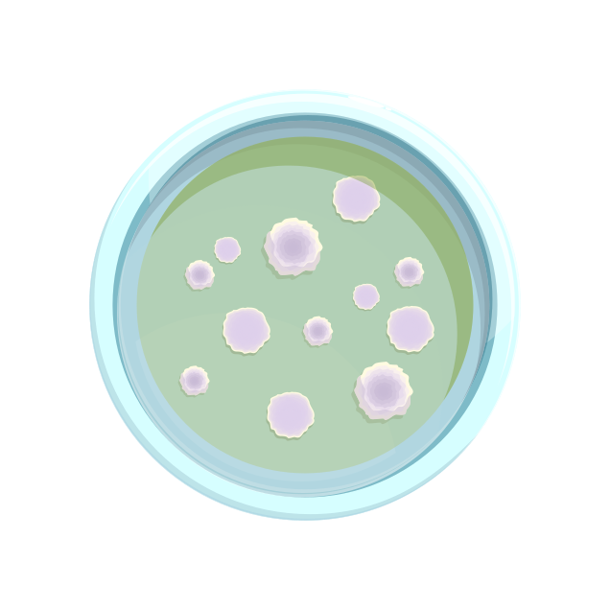
Nitrocefin Disk Test:
1. Moistening Disks: Nitrocefin disks were moistened with distilled water.
2. Inoculation with Bacterial Colonies: Bacterial colonies grown in the presence of penicillin disks (for induced cultures) were smeared onto the surface of the nitrocefin disks.
3. Observation: The disks were observed for a color change from yellow to deep orange, indicating beta-lactamase activity.
4. Interpretation: The color change was interpreted as a positive result for beta-lactamase production

Slide 13
β-LEAF Assay (Fluorescence-Based Detection)
Detects β-lactamase activity in real-time using a fluorescent probe.
Performed in 96-well plates with bacterial suspension + β-LEAF probe.
Fluorescence increase = β-lactamase cleavage of the probe.
🎯 Advantages
Sensitive & quantitative.
High-throughput compatible.
Useful for testing antibiotic resistance.
🎨 Nitrocefin Disk Test (Colorimetric Detection)
Nitrocefin changes color (yellow → red) when cleaved by β-lactamase.
Simple visual test using disks & bacterial colonies.
Fast, reliable screening method.

Slide 14


BIOT 684: DIRECTED PROFESSIONAL INTERNSHIP

Slide 15

About GSK
GSK plc, or GlaxoSmithKline, is a global biopharma company that develops, manufactures, and commercializes general and specialty medicines and vaccines. They focus on science, technology, and talent to prevent and treat diseases, particularly in respiratory, immunology, oncology, and HIV/infectious diseases. GSK invests heavily in research and development, aiming to impact health at scale.
Key aspects of GSK:
Focus:
GSK is a biopharma company, meaning it focuses on developing and manufacturing biological medicines.
Core Areas:
They target respiratory, immunology, oncology, and HIV/infectious diseases.
Innovation:
GSK emphasizes innovation in specialty medicines and vaccines to prevent and treat diseases.

Slide 16


Evaluation of Proteomic Stabilizer for the Extended
Storage of NHP Red Blood Cells
Palak Nagar
Jamie Williams

Slide 17

What is a Proteomic Stabilizer and
Why are we trying it?
Used to preserve whole blood and cell suspensions
Can be used to store samples for subsequent analysis days, weeks,months later
Length of stabilization dependent on stability of markers
Stabilization of red blood cells could be useful for assessing proteins on surface of red blood cells

Slide 18




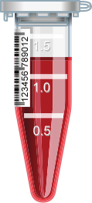

PROCESS TO STABILIZE BLOOD
BRIC 6 APC
Blood was collected from 3 monkeys in accordance with GSK's Policy on the Care, Welfare and Treatment of Lab Animals and reviewed by the Institutitonal Animal Care and Use Committee at GSK.
Adding the stabilizer on all the 3 subsets and incubating it for 10 mins in room
temperature.
Freeze it at -80 C for a week (approx.)
For one subset of each monkey we added 250ul of diluted BRIC6 APC and rest it for 20
mins

Slide 19
PROCESS OF THAWING & STAINING
Thaw the frozen samples at 4C for 30 mins.
Prepare the compensation beads, single stains and FMOs of the antibodies.
Prepare the full panel samples namely:
Full Panel + CD45 + Dil. BRIC 6-FITC | Monkey 1 | Monkey 2 | Monkey 3
Proteomic Stabilizer only | 2 Replicate | 2 Replicate | 2 Replicate
Stabilizer + prestained BRIC 6 APC | 2 Replicate | 2 Replicate | 2 Replicate

Slide 20



GATING STRATEGY
FSC-A
Singlets
FSC-A
RBCs
FSC-H
SSC-A
APC +ve
BRIC6 APC
CD-45
FITC +ve
Live Cells
BRIC6 FITC
Viability

Slide 21

Viability testing
Evaluated ability of fixable viability dye eFluor780 to bind damaged RBCs
Viability dye added to CD45 FMO for a quick check
Unstained sample and sample including viability looks comparable
Suggests viability dye is not bind RBCs

Slide 22


Stabilized Isolated
Blood Process

Slide 23

Data Analysis
Day 2 Observations
BRIC-6 APC and BRIC-6 FITC staining patterns between the two analysts were inconsistent, making it difficult to interpret the data
Currently unable to determine which staining pattern is correct

Slide 24

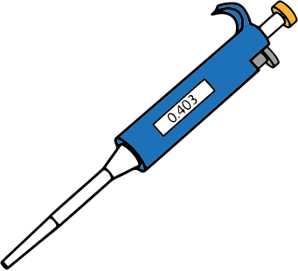
Data Analysis
Day 7 Observations
Observed changes in the light scatter properties of RBC 7 days post-stabilization
Unclear if this is a function of the proteomic stabilizer or antibody aggregation
Except two samples, the staining patterns between the two analysts are more consistent
Changes in light scatter properties and the inability to quantify consistent BRIC-6 FITC/APC double positive RBCs suggests additional work is required to confirm or reject the ability to use a proteomic stabilizer for the reservation of RBCs

Slide 25
Conclusions
01
02
03
Inconsistent staining patterns between analysts on Day 2 make it difficult to interpret
data
Altered light scatter properties on Day 7 suggest stabilizer may be interfering with the
structural integrity of the RBCs or suggestive of antibody aggregation
Additional experiments should be performed to confidently exclude proteomic stabilizer
for RBCs
Would not recommend as an appropriate reagent for extended storage of RBCs

Slide 26
Thank
you!
Questions?

